Slide 1
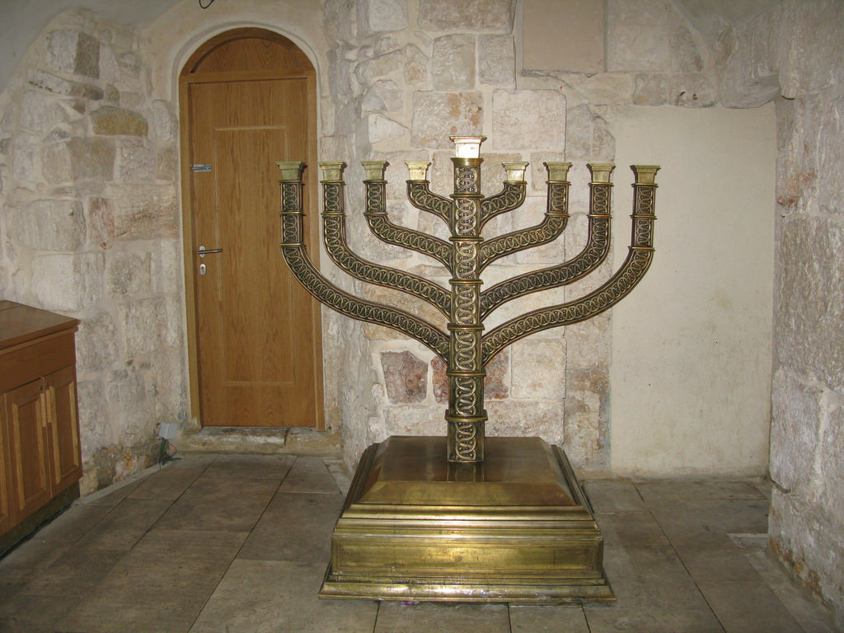
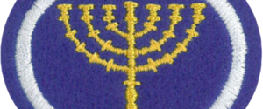
Sanctuary
GC Honor
Notes:
We make it more complex than needed.
We sometimes want to spiritualize every aspect

Slide 2
The 4 main points of the Sanctuary
The Function
– three key parts
The High Priest / King Role
– order of Melchizedek
The Prophecies
– of the King / Priest
The Promise
– new Jerusalem
Notes:
We make it more complex than needed.
We sometimes want to spiritualize every aspect

Slide 3
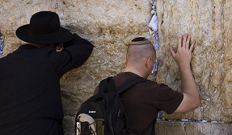
Sanctuary – the King’s Throne
Exodus 25: 8-9 (NIV)
⁸ "Then have them make a sanctuary for me, and I will dwell among them.
⁹ Make this tabernacle and all its furnishings exactly like the pattern I will show you.
Notes:
How was God throne different from all the kings
10 Commandments, Aaron’s Rod, Manna

Slide 4
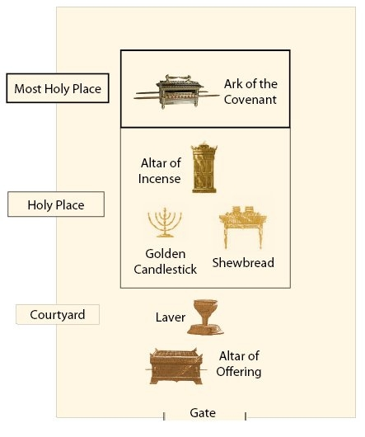
Sanctuary
The King’s Throne
How the ancient world
visited their king
How our King
visited us
Notice the three areas

Slide 5
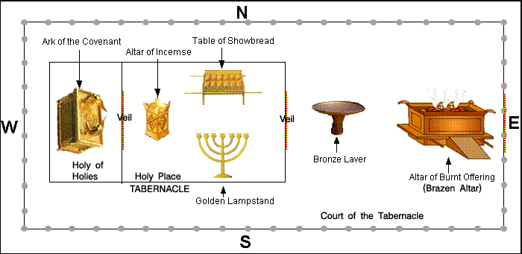

Quiz #1
Explain how the Sanctuary works
From the gate to the throne – How do we visit a king?
From the throne to the gate – How does the king visit us?
What was added? - King / Priest
Bonus Question – what 3 items where in the ark?
Notes:
How was God throne different from all the kings
10 Commandments, Aaron’s Rod, Manna

Slide 6
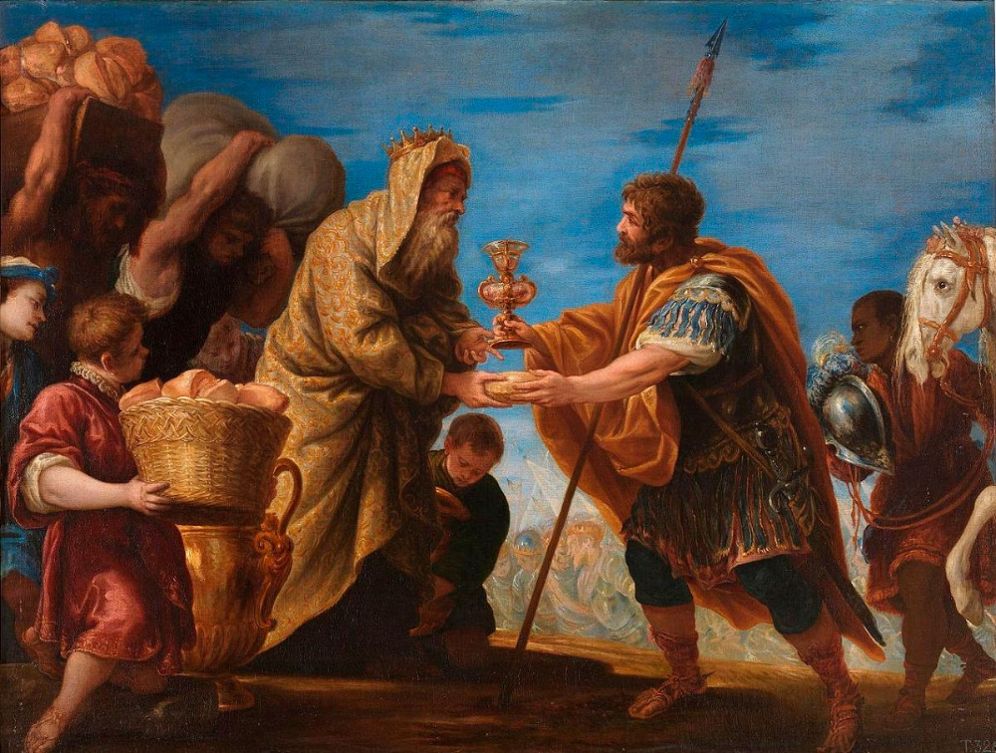
Jesus the King / Priest
Hebrews 7:17
(Gen 14:18-20)
For it is declared: "You are a priest forever, in the order of Melchizedek." (NIV)
Who was Melchizedek? →
Priest & King
Notes:
King of Salem & High Priest
Heb 6:20

Slide 7
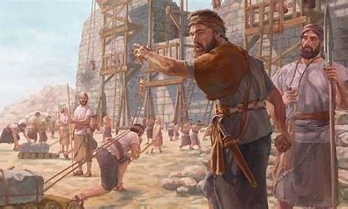
Zerubbabel & Joshua - rebuilders
Haggai 1:14 So the LORD stirred up the spirit of Zerubbabel son of Shealtiel, governor of Judah, and the spirit of Joshua son of Jozadak, the high priest, and the spirit of the whole remnant of the people. They came and began to work on the house of the LORD Almighty, their God,

Slide 8
Zerubbabel & Joshua - rebuilders
Zechariah 4: 9 "The hands of Zerubbabel have laid the foundation of this temple; his hands will also complete it. Then you will know that the LORD Almighty has sent me to you.

Slide 9
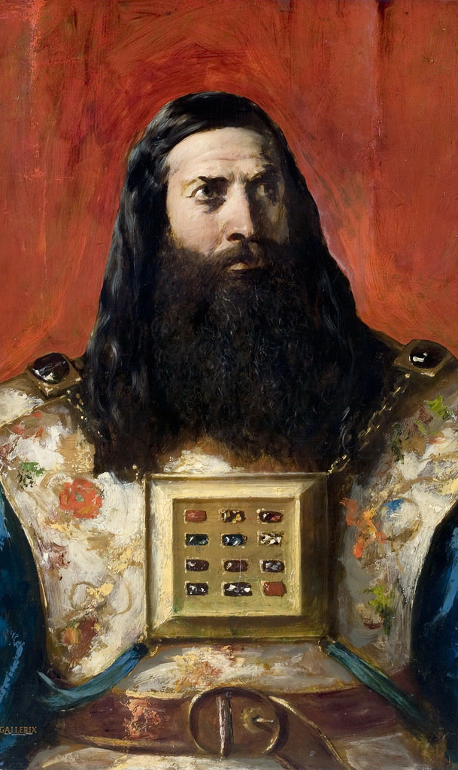
Jesus – King / Priest
Zechariah 3:8
" 'Listen, High Priest Joshua, you and your associates seated before you, who are men symbolic of things to come: I am going to bring my servant, the Branch.

Slide 10
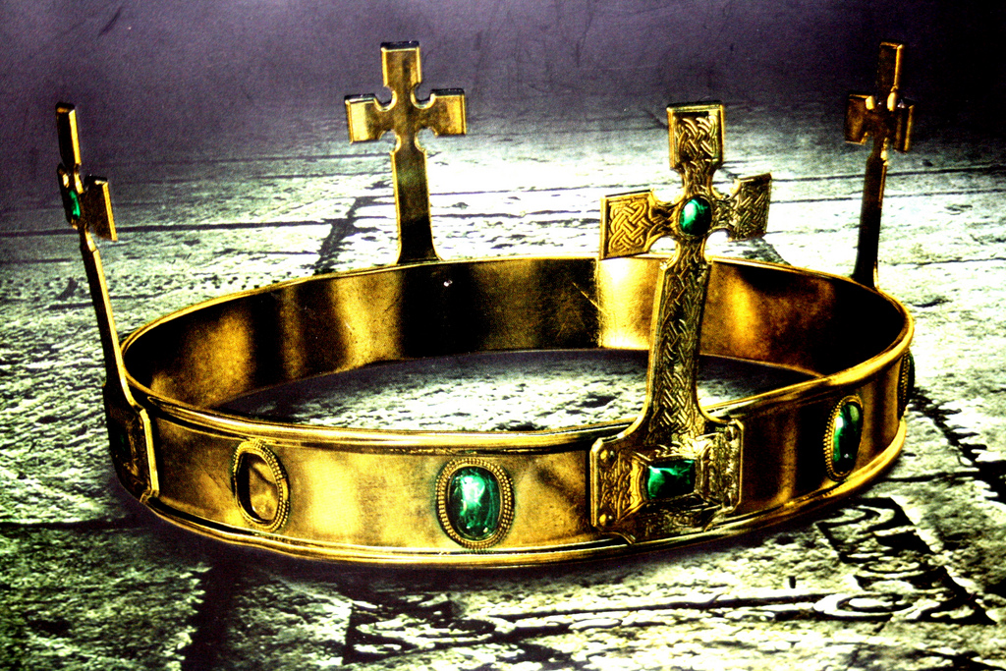
Jesus the King / Priest
Zechariah 6:11,12
¹¹ Take the silver and gold
and make a crown, and set it on the head of the high priest, Joshua son of Jozadak.
¹² Tell him this is what the LORD Almighty says: 'Here is the man whose name is the Branch, and he will branch out from his place and build the temple of the LORD.

Slide 11
Jesus the King / Priest
Zechariah 6:13
¹³ It is he who will build the temple of the LORD, and he will be clothed with majesty and will sit and rule on his throne. And he will be a priest on his throne. And there will be harmony between the two.’

Slide 12
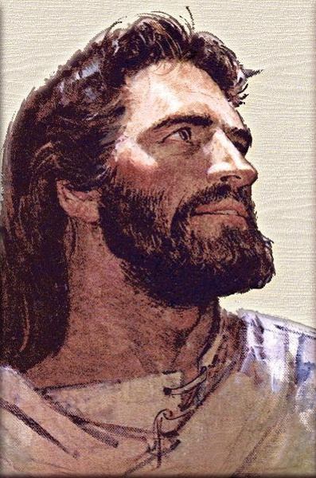
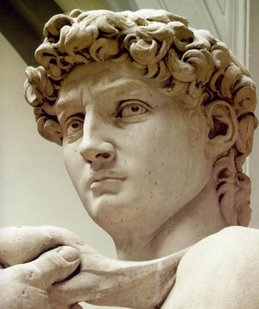
Jesus is from King David (Father’s side)
Matt 1:1 A record of the genealogy of Jesus Christ the son of David, the son of Abraham: (NIV)
6 and Jesse the father of King David. David was the father of Solomon, whose mother had been Uriah's wife,
16 and Jacob the father of Joseph, the husband of Mary, and Mary was the mother of Jesus who is called the Messiah.
Notes:
Jesus is Blue Blood via Joseph his dad.

Slide 13
Jesus is from King David
(Luke follows the legal lineage while Matthew follows the biological)
Luke 3:23 Now Jesus himself was about thirty years old when he began his ministry. He was the son, so it was thought, of Joseph, the son of Heli,
27 the son of Joanan, the son of Rhesa, the son of Zerubbabel, the son of Shealtiel, the son of Neri,
31 the son of Melea, the son of Menna, the son of Mattatha, the son of Nathan, the son of David,
Notes:
Jesus is Blue Blood via Joseph his dad.

Slide 14
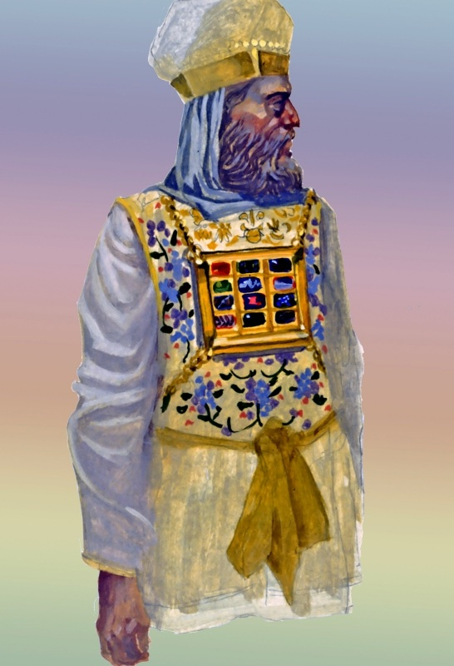
Jesus the King / Priest
Luke 1:5-7 (NIV)
⁵ In the time of Herod king of Judea there was a priest named Zechariah, who belonged to the priestly division of Abijah; his wife Elizabeth was also a descendant of Aaron.
⁶ Both of them were upright in the sight of God, observing all the Lord's commandments and regulations blamelessly.
⁷ But they had no children, because Elizabeth was barren; and they were both well along in years.

Slide 15
Jesus the King / Priest
Luke 1:36-37 (NIV)
³⁶ Even Elizabeth your relative is going to have a child in her old age, and she who was said to be barren is in her sixth month.
³⁷ For nothing is impossible with God."

Slide 16
Jesus the King / Priest
Heb 7:17 For it is declared: "You are a priest forever, in the order of Melchizedek." (NIV)
Judah
Levi (and/or) Melchizedek

Slide 17
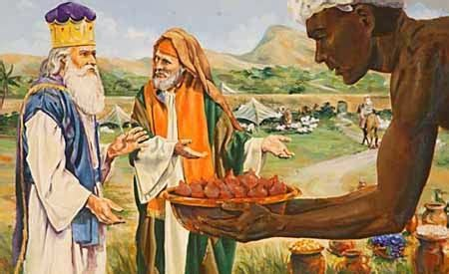
Quiz #2
Explain the following
Who was Melchizedek?
How was Jesus a King?
How was Jesus a Priest?

Slide 18
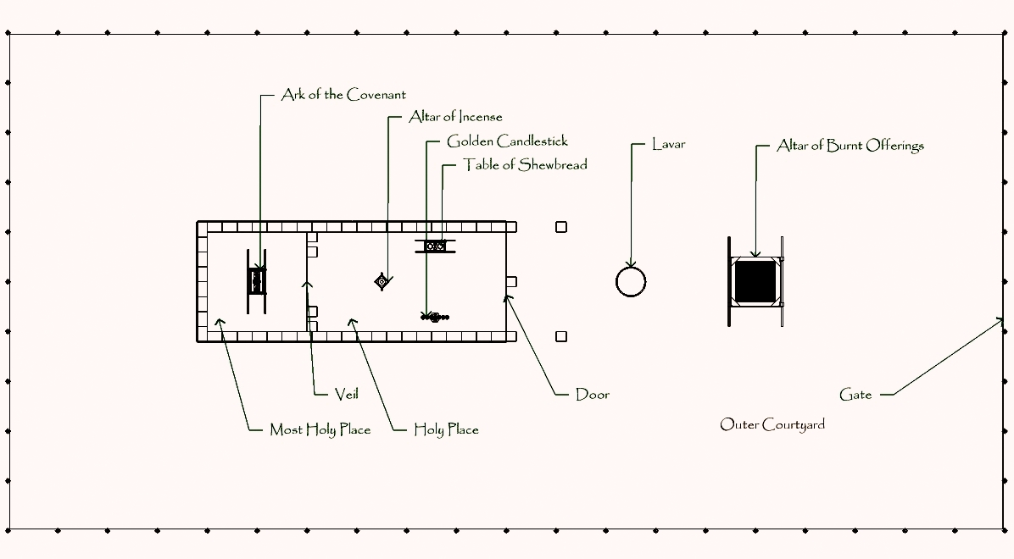
Sanctuary – Function of the High Priest
The Daily & Yearly Sacrifices & the Goat
Yearly
Exodus 29:38-39
Twice a day for a year a lamb was sacrificed – Why?
Notes:
We go to the king
The Kings comes to us
We go through the Priest

Slide 19
Sacrifice – the daily / yearly
The two goats
Christ and Satan - the great controversy
Yearly
Died
Lived
Leviticus 16:34
Notes:
Confessed sins
The sins were deposited - daily
The sins were withdrawn – once a year and placed on Satan One goat was Christ – the other Satan

Slide 20
Why the Blood?
Hebrews 9:7
But only the high priest entered the inner room, and that only once a year, and never without blood, which he offered for himself and for the sins the people had committed in ignorance. (NIV)

Slide 21
Why the Blood?
Hebrews 9:22
In fact, the law requires that nearly everything be cleansed with blood, and without the shedding of blood there is no forgiveness. (NIV)

Slide 22
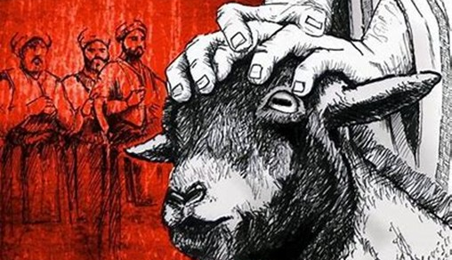
Quiz #3
Explain the following
1. Why were two lambs sacrificed daily?
2. Why was the temple cleaned yearly? (Yom Kippur)

Slide 23
Jesus does three main parts
He dies for us
He cleanses the records
He is coming again

Slide 24
Prophecy – part 1(Jesus the sacrifice)
Daniel 9:24 "Seventy 'sevens' are decreed for your people and your holy city to finish transgression, to put an end to sin, to atone for wickedness, to bring in everlasting righteousness, to seal up vision and prophecy and to anoint the most holy. (NIV)
457 BC
1844 AD
31 AD
490 years
2300 years
Why the 490-year prophecy? The King came to Earth
Notes:
Why 490 years? 70 years exile because never gave land a rest. Also, from Saul to last king. 490 years.
Why 1,000 years?

Slide 25
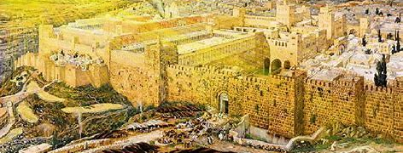
The promise John 14:1-3
1"Do not let your heart be troubled; believe in God, believe also in Me.
2"In My Father's house are many dwelling places; if it were not so, I would have told you; for I go to prepare a place for you.
3"If I go and prepare a place for you, I will come again and receive you to Myself, that where I am, there you may be also.…

Slide 26
Prophecy – part 2
(Jesus Cleanses the records)
Daniel 8:14 He said to me, "It will take 2,300 evenings and mornings; then the sanctuary will be reconsecrated." (NIV)
457 BC
31 -34 AD
1844 AD
490 years
2300 years
Why 2,300-year prophecy? The Priest when to Heaven for two things – prepare a place for us, and to cleanse the Sanctuary
Notes:
538 BC to 1844 AD = 2,300 years

Slide 27
Prophecy - part 3
(Jesus 2nd Coming & the Goat)
The two goats – Christ and Satan the great controversy
The sins are given back to Satan – 1000 years begins
457 BC
Yearly
31 - 34 AD
1844 AD
2nd Coming
490 years
2300 years
1000 years
After the Sanctuary is cleansed and the gospel is shared to all the earth,
The King comes to Earth – Satan remains in the wilderness for 1,000 years
Notes:
Why a thousand years – 6,000 for the limit for sin, 1,000 for a Sabbath rest

Slide 28
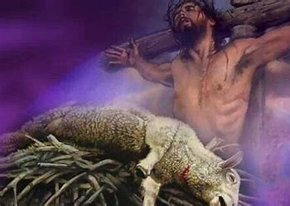
The Promise
Hebrews 9:28
So Christ was sacrificed once to take away the sins of many; and he will appear a second time, not to bear sin, but to bring salvation to those who are waiting for him.
Notes:
When False Christ comes then everyone will make a decision. Death seals your choice – while living you still can choose.

Slide 29

Daniel 12:1-2
1 "At that time Michael, the great prince who protects your people, will arise. There will be a time of distress such as has not happened from the beginning of nations until then. But at that time your people—everyone whose name is found written in the book—will be delivered.
2 Multitudes who sleep in the dust of the earth will awake: some to everlasting life, others to shame and everlasting contempt.

Slide 30
Quiz #4
Explain the following
Why 490 years? – Lamb gave His blood
Why 2,300 years? – Records are cleansed
Why does Jesus come again?
Why a thousand years? – Sabbath Rest
What happens when Christ comes – New Home

Slide 31
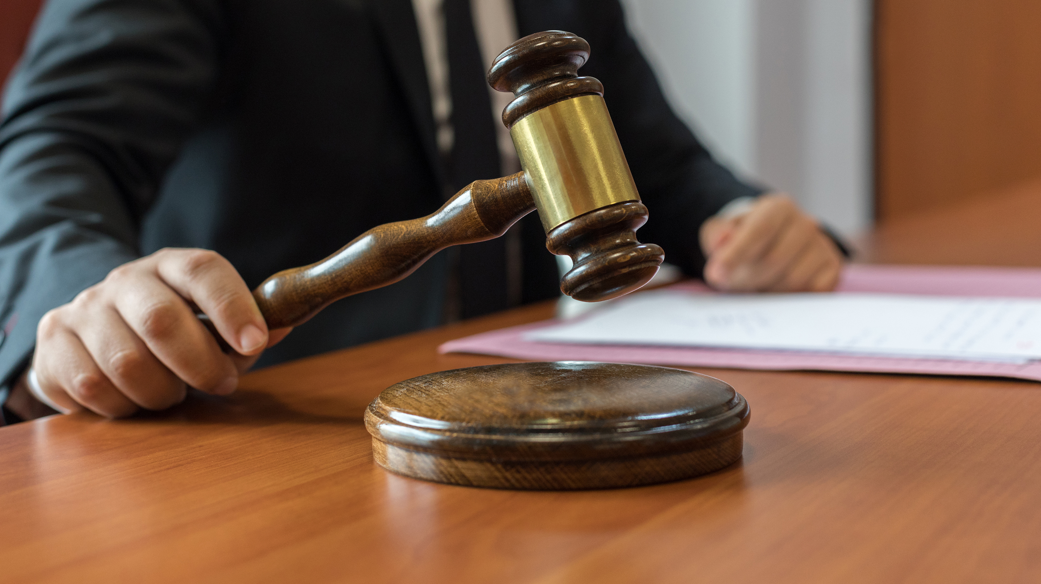
John 1:29
²⁹ The next day John saw Jesus coming toward him and said, “Look, the Lamb of God, who takes away the sin of the world! (NIV)
Pause – let’s revisit the judgement

Slide 32
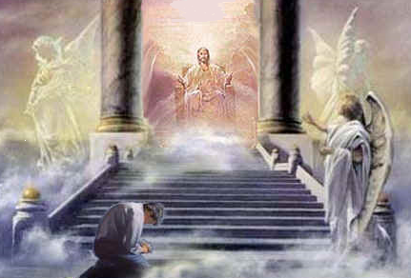
Acts 10:42-43
⁴² He commanded us to preach to the people and to testify that he is the one whom God appointed as judge of the living and the dead.
⁴³ All the prophets testify about him that everyone who believes in him receives forgiveness of sins through his name.”(NIV)

Slide 33
The Sanctuary explains how the Judgment works
Let’s see the future judgment hall
God JC (died) You
We are cleansed by the Blood of Jesus Christ

Slide 34
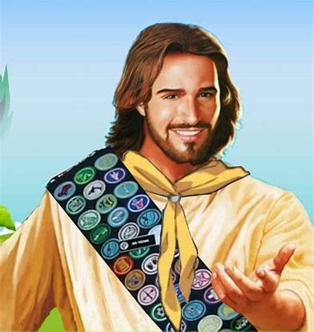
Congrats! You have completed the Honor

Slide 35

Extra – if we have time
1 Kings 6:20 - The inner sanctuary was twenty cubits long, twenty wide and twenty high.
Rev. 21:16 The city was laid out like a square, as long as it was wide. He measured the city with the rod and found it to be 12,000 stadia in length, and as wide and high as it is long.

Slide 36
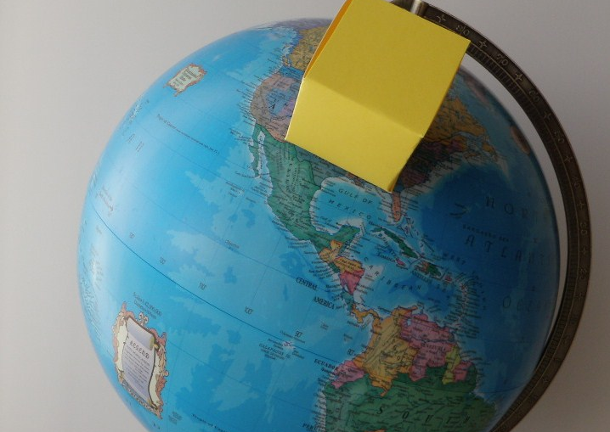
Size of the New Jerusalem – 1,400 miles wide
Notes:
The Throne in the Old Testament was a cube.
NT the new Jerusalem – in my Father’s house are many rooms = Rev. 21:15-17
In my Father’s house are many rooms. - what is coming down is the Father’s house

Slide 37

Final Quiz
Questions
What in the Sanctuary is a cube?
How big is the Father’s House or New Jerusalem?
Your director can order the Sanctuary Honor – Have a great day!

Slide 38
Extras
The Great Controversy; Chapter 28 — Facing Life's Record; 488.2 [1]
"... The subject of the sanctuary and the investigative judgment should be clearly understood by the people of God. All need a knowledge for themselves of the position and work of their great High Priest. Otherwise it will be impossible for them to exercise the faith which is essential at this time or to occupy the position which God designs them to fill. Every individuals has a soul to save or to lose. Each has a case pending at the bar of God. Each must meet the great Judge face to face. How important, then that every mind contemplate often the solemn scene when the judgment shall sit and the books shall be opened, when, with Daniel, every individual must stand in his lot, at the end of days. (488.2) All who have received the light upon these subjects are to bear testimony of the great truths which God has committed to them. The sanctuary in heaven is the very center of Christ's work in behalf of men. It concerns every soul living upon the earth. It opens to view the plan of redemption, bringing us down to the very close of time and revealing the triumphant issue of the contest between righteousness and sin. It is of the utmost importance that all should thoroughly investigate these subjects and be able to give an answer to everyone that asketh them a reason of the hope that is in them." (488.3)

Slide 39
Extras
Hebrews 4:14-16 (NIV)
¹⁴Therefore, since we have a great high priest who has gone through the heavens, Jesus the Son of God, let us hold firmly to the faith we profess. ¹⁵For we do not have a high priest who is unable to sympathize with our weaknesses, but we have one who has been tempted in every way, just as we are—yet was without sin. ¹⁶Let us then approach the throne of grace with confidence, so that we may receive mercy and find grace to help us in our time of need."

